Slide 1




YOUTH TOUR
CULTURAL TOURISM IN BULGARIA
This publication has been produced with the assistance of the European Union through the Interreg-IPA CBC Bulgaria-Turkey Programme, CCI No 2014TC16I5CB005.
The contents of this publication are the sole responsibility of Geo Milev English Language Secondary School and can in no way be taken to reflect the views of the European Union or the Managing Authority of the Programme.

Slide 2
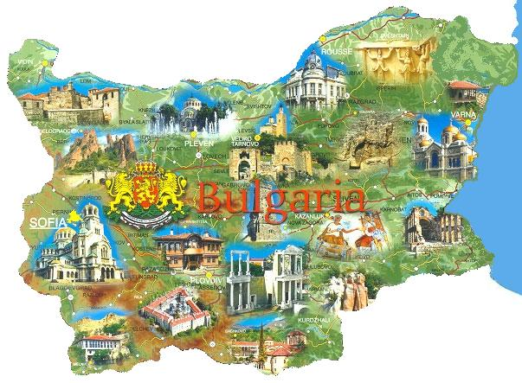
Bulgaria is in Europe.
It is situated on the Balkan Peninsula.

Slide 3
Cultural tourism is a combination of two concepts - culture and tourism. To be entirely accurate we have to consider the concept "culture" in its narrow and broad sense. In a narrow sense, the term "culture" refers to historical and artistic aspects of a sector, such as monuments, museums, etc., and how they are presented in the classic tourist catalogues. In a broader sense, the culture includes customs, traditions, crafts, historical and modern technical monuments, national cuisine, language, etc. It is there with everything we do, it is shown in public and private life, in our daily lives, in our holidays and in our beliefs.

Slide 4
Cultural tourism is a child of two parents - Culture and Tourism, as a result of "marriage" of the two they have formed one union. Therefore, the trends in the development of cultural tourism largely reflect the trends of the role of cultural heritage and tourism in today and tomorrow's world.
Today, in the era of globalization and unprecedented mobility, cultural heritage determines the choice of the human living environment. The settings with memory more lasting begin to attract people and investment activities.
In recent years, cultural tourism has developed as one of the most successful tourism industries in the world. The number of tourists motivated by culture and heritage is constantly growing.
Tourism practices promote cultural heritage as a true "gold mine" for the development of national economies.
The relationship between cultural and natural resources of Bulgaria makes it an attractive as well as competitive tourist destination. Bulgaria is a country with high potential for tourism development, consisting of its cultural heritage.
As a result, we can summarize that the tangible and intangible cultural heritage and natural attractions can be an engine for economic growth in Bulgaria that not only stimulates the local economy, but also national.

Slide 5
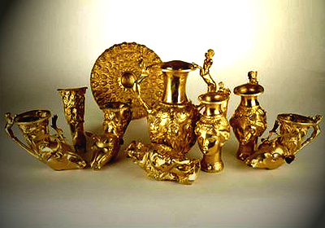
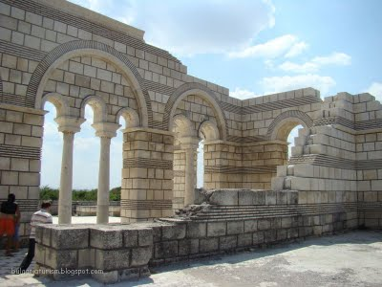
Bulgaria was founded in 681. It is one of the oldest countries in Europe.
Pliska was the first Bulgarian capital.

Slide 6
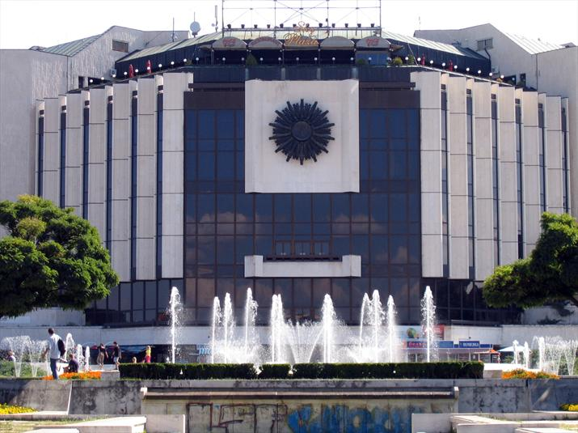
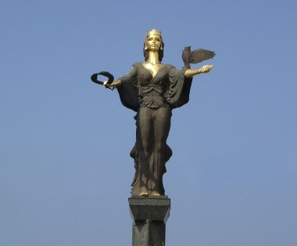
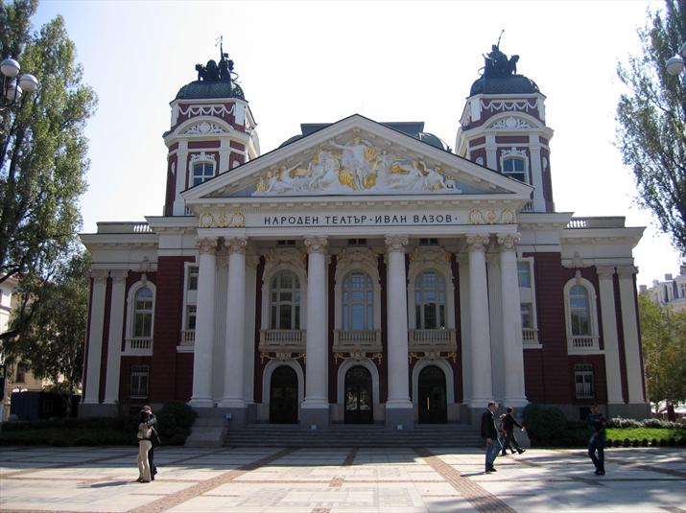
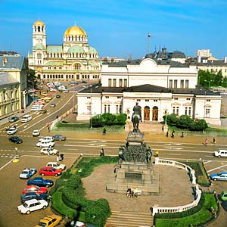
Sofia is the capital of Bulgaria. Sofia is an ancient city with a rich history. The city was founded by a Thracian tribe 3000 years ago.

Slide 7
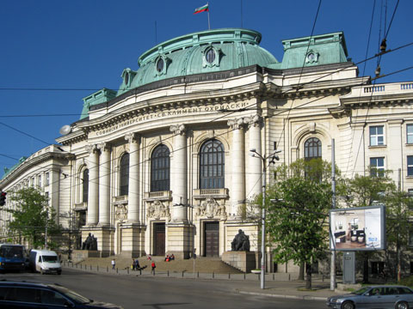
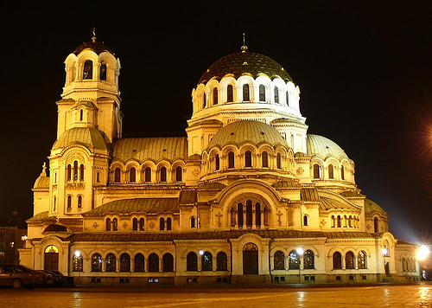
Sofia - There are a lot of museums, universities, theatres, monuments, famous buildings and parks.
The Alexander Nevski Cathedral is the biggest church in Bulgaria.

Slide 8
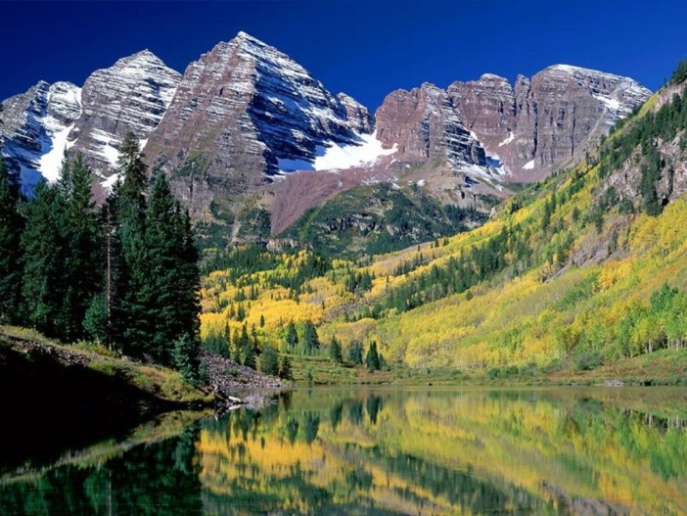
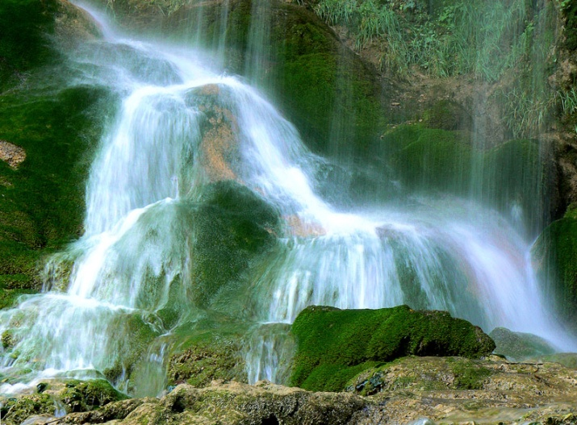
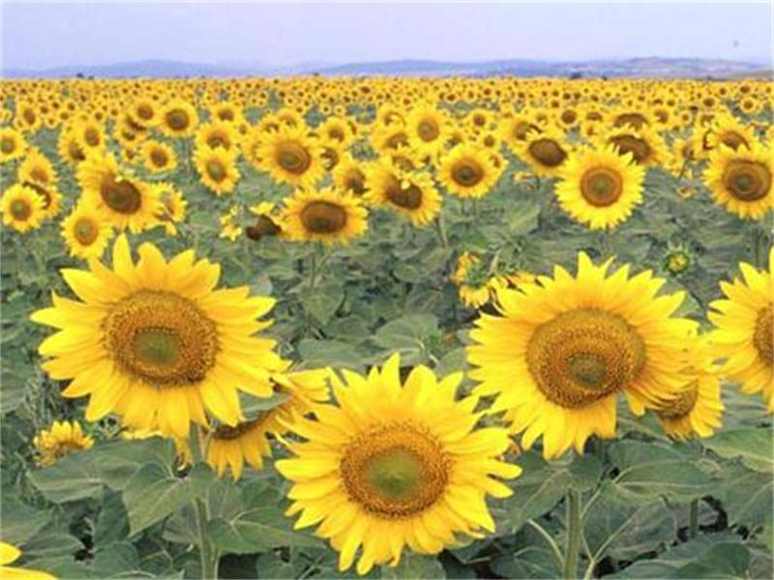
Bulgaria is famous for its beautiful nature. There are a lot of high mountains, vast plains, rivers and lakes.

Slide 9
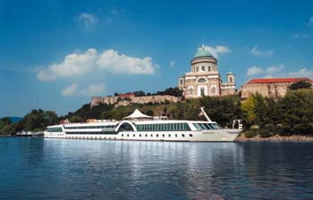
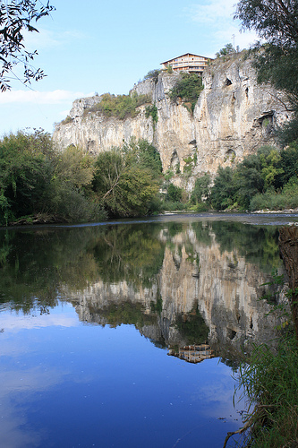
The Danube is the longest river in the European Union. It is an important international waterway.
Iskar is the longest river in Bulgaria.

Slide 10
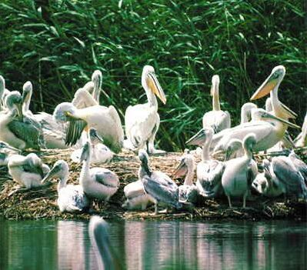
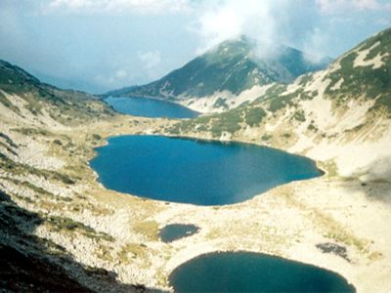
Lakes - The Srebarna Nature Reserve is a freshwater lake near the Danube. There are almost 100 species of birds, many of which are rare or endangered.
The 7 Rila Lakes is the biggest and most visited group of lakes in the Rila Mountains. Each of the lakes is named according to its shape.

Slide 11
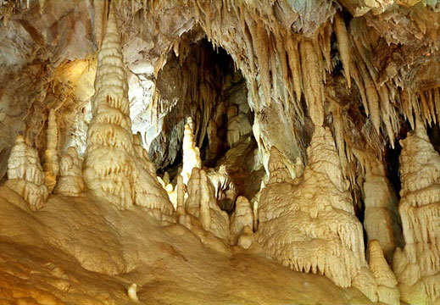
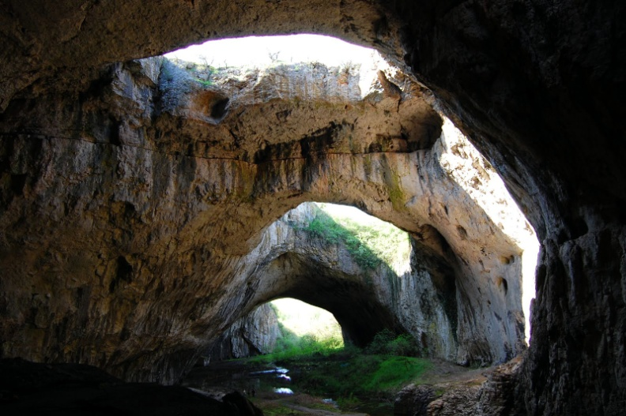
Caves - There are more than 4000 caves in Bulgaria.
The Devetashka Cave impresses with its enormous size.

Slide 12
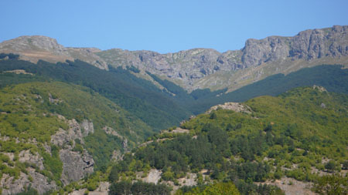
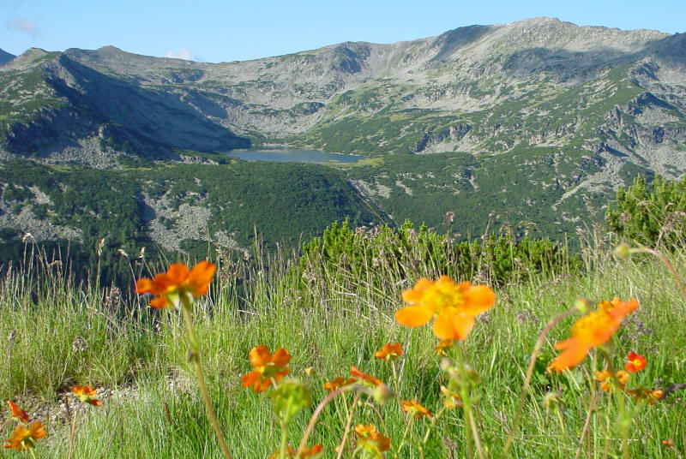
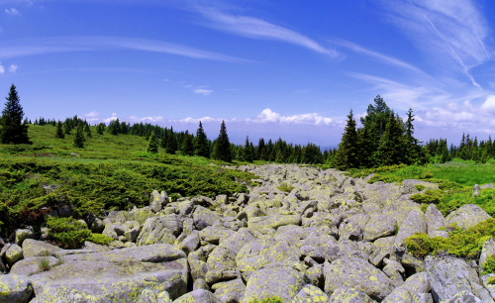
The Balkan Mountains is the longest mountain in Bulgaria.
The Rila Mountain is the highest mountain in Bulgaria.
Vitosha Mountain is a beautiful national park. It rises above Sofia and it is one of the symbols of our capital city.

Slide 13
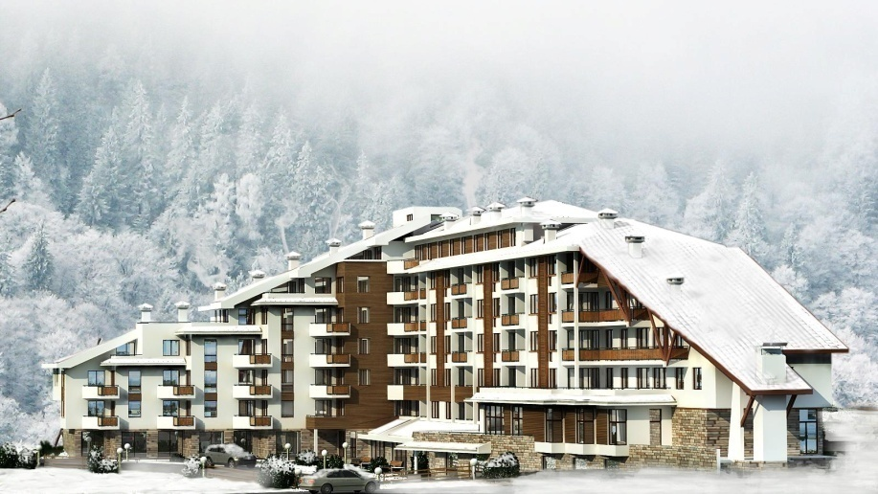
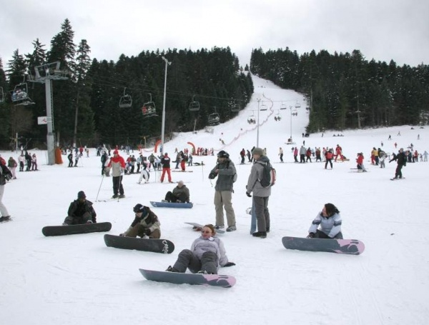
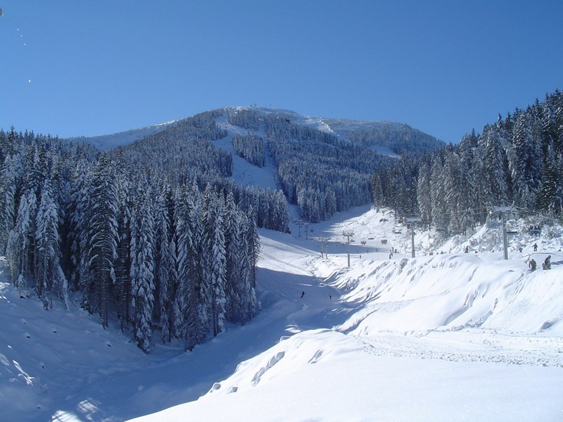
Mountain resorts
Pamporovo, Borovets and Bansko are modern ski resorts. They are the sunniest mountain resorts with wonderful snow in winter.

Slide 14
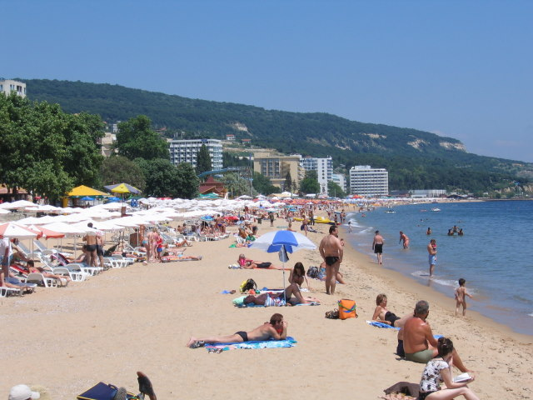
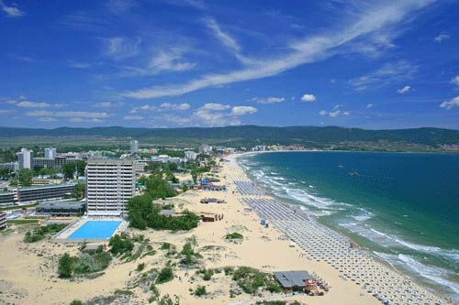
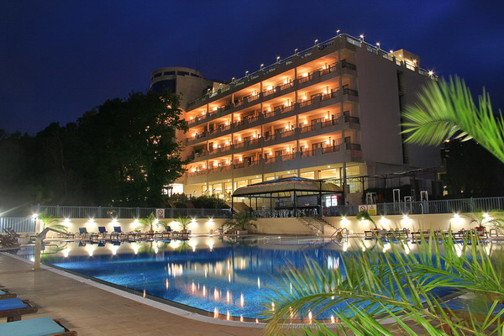
Sea resorts
You can see large beaches and beautiful rocky shores along the Black Sea coast.
Golden Sands, Albena, Sunny Day, Sunny Beach are the most famous sea resorts.

Slide 15
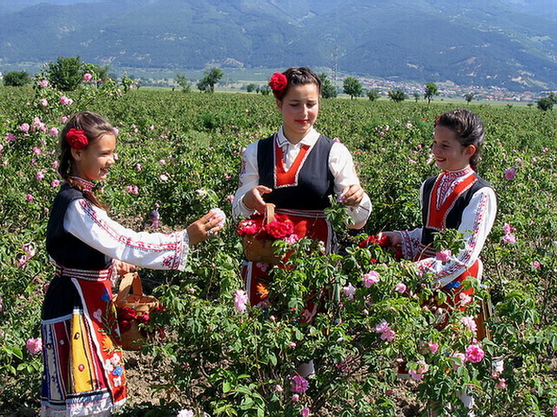
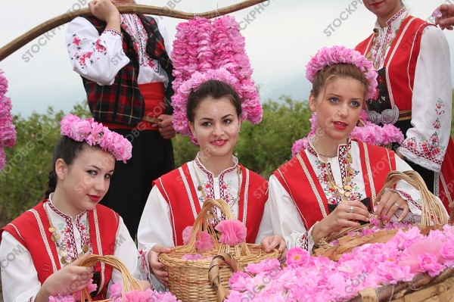
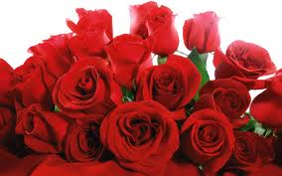
The rose Valley - The Valley of the roses is one of the most romantic places in Bulgaria.
The red rose is the symbol of Bulgaria.

Slide 16
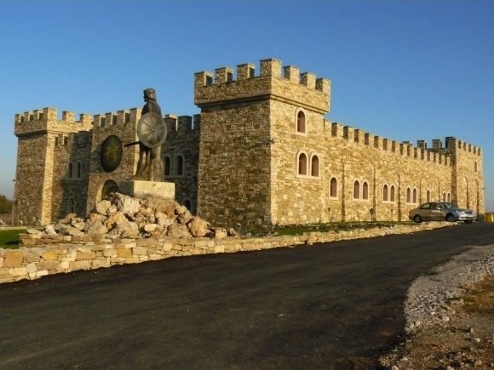
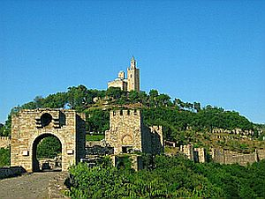
CITIES
Veliko Tarnovo is a beautiful historical town.
The royal city was the capital of the Second Bulgarian kingdom.
A central place is occupied by the ruins of the royal palace.

Slide 17
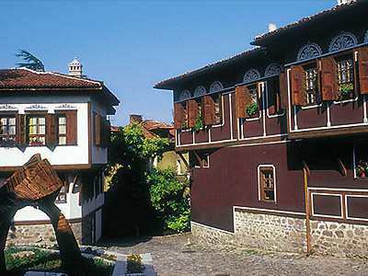
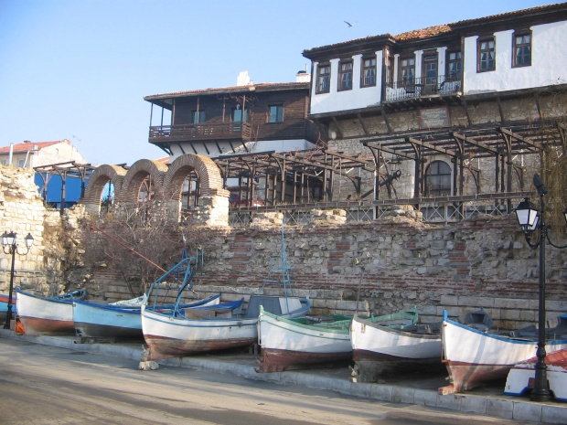
Cities
Ancient city of Nessebar is situated on a rocky peninsula of the Black Sea.
Wooden houses built in the 19th century are typical of the Bulgarian architecture.

Slide 18
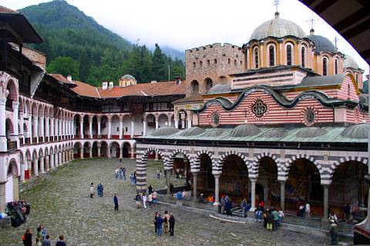
Monasteries - There are more than 140 monasteries in Bulgaria.
Rila Monastery is the best-known. It was established in 10th century.

Slide 19
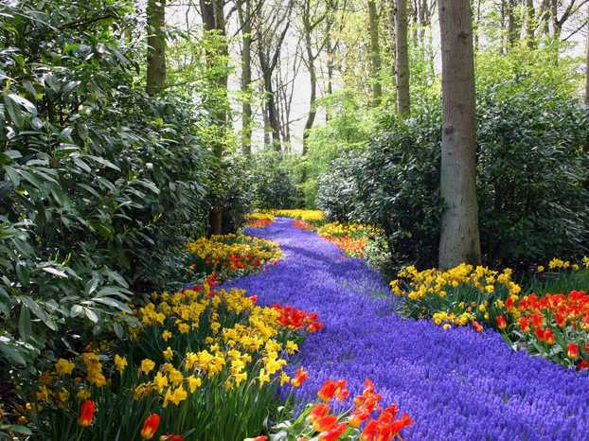
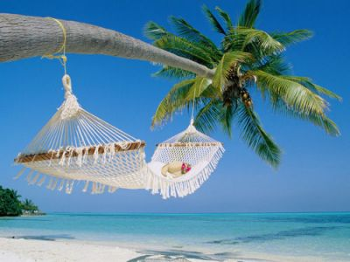
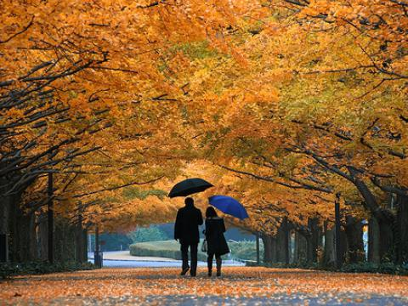
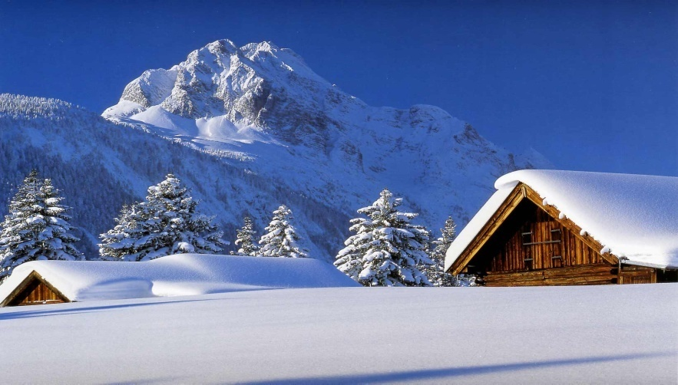
Climate - There are 4 seasons in Bulgaria.
It`s hot in summer.
Many people go to the seaside.
In spring everything is green. There are many flowers.
In autumn the weather changes.
It often rains. The leaves fall.
There is a lot of snow in winter.
It`s cold.

Slide 20
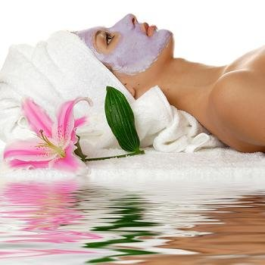
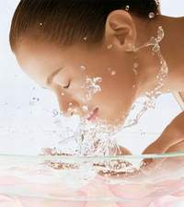
Country of health - Bulgaria is an extremely attractive center for treatment, recreation and tourism with its numerous resorts, nice climate, wonderful beaches and over 500 mineral springs.

Slide 21
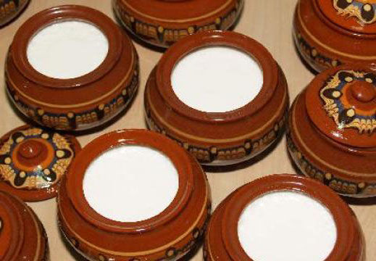
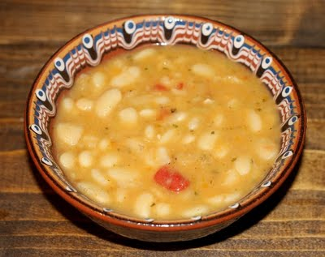
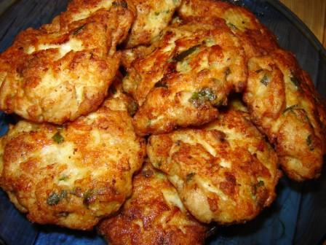
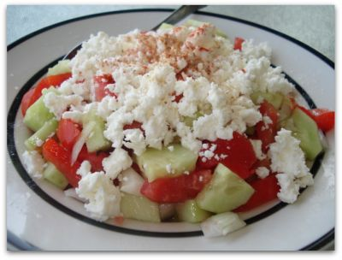
Food - Bulgarian food is delicious. Here are some typical national dishes:
Bulgarian yoghurt is the best in the world.
Bean soup is very popular.
Bulgarian people love to eat meat balls and shopska salad.

Slide 22
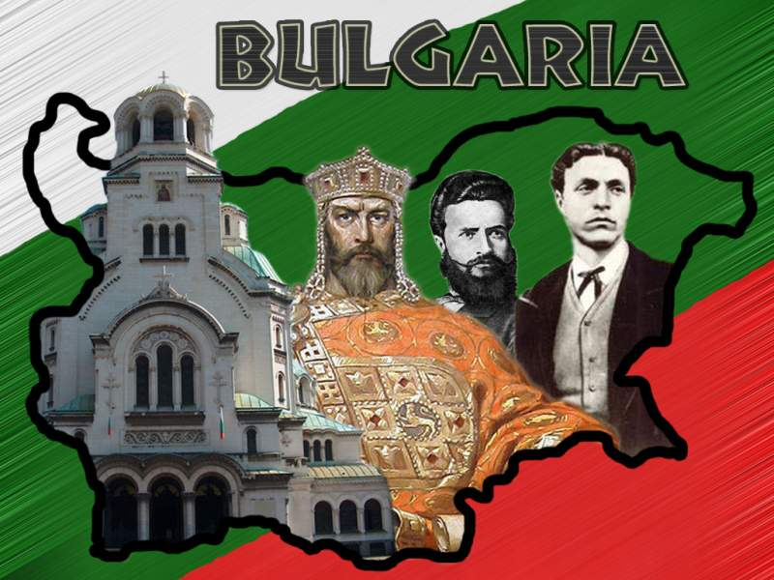
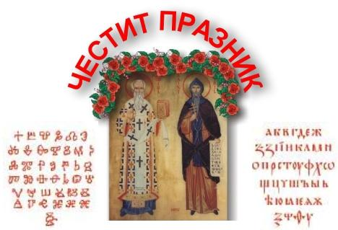
Holidays - The Bulgarian national holiday is on 3rd March. We celebrate the liberation from Ottoman rule.
On 24th May we celebrate the Day of the Bulgarian alphabet.

Slide 23
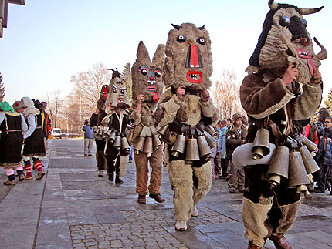
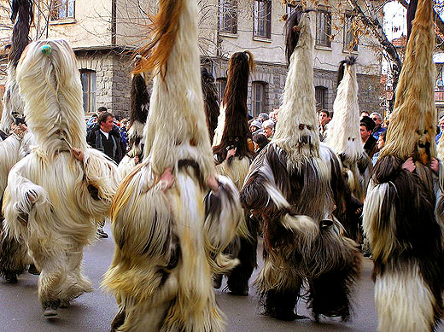
Festivals and special days
We have an interesting Bulgarian tradition.
Only men take part in the Mummers` Games in March. They put scary masks and costumes.
They go dancing in streets. Everyone is noisy and happy.
Mummers

Slide 24
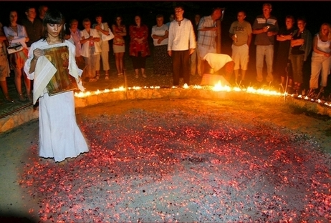

Nestinarstvo is an old Bulgarian ritual. It involves a barefooted dance on embers.
It is performed on the Day of Sts. Constantine and Helen and attracts a lot of tourists.

Slide 25

THANK YOU FOR YOUR ATTENTION!

