Slide 1




YOUTH TOUR
ECO AND RURAL TOURISM
This publication has been produced with the assistance of the European Union through the Interreg-IPA CBC Bulgaria-Turkey Programme, CCI No 2014TC16I5CB005.
The contents of this publication are the sole responsibility of Geo Milev English Language Secondary School and can in no way be taken to reflect the views of the European Union or the Managing Authority of the Programme.

Slide 2
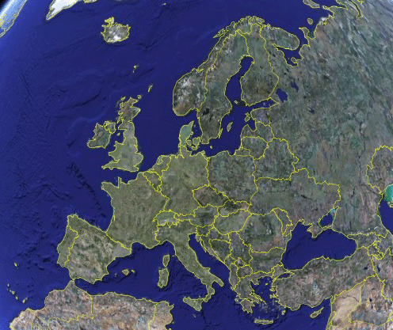
Eco and Rural Tourism.
A change of paradigm?

Slide 3
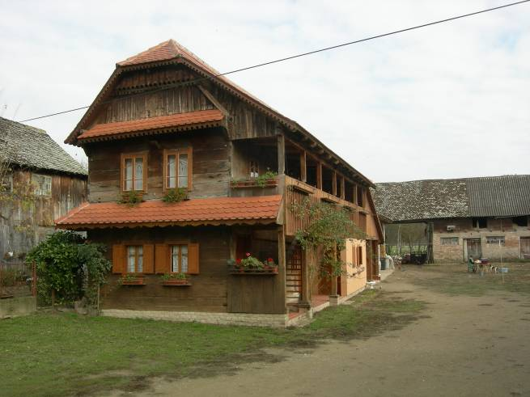

Slide 4
Definition
Within the global Tourism Economy, the Rural Tourism is defined by the valorisation through tourism of
  agrarian spaces,
  natural resources,
  cultural heritage,
  rural housing,
  local popular traditions and products
through specially labelled products that reflect the regional identities and cover the needs of the consumer for
  accommodation,
  gastronomy,
  leisure activities,
  animation, and
  other services,
  with the objective of a local sustainable development and an adequate answer to the needs of leisure of the modern society within a new social solidarity between city and countryside (EuroTer)

Slide 5
Rural Tourism - History
Spontaneous phenomen in West and Central Europe since beginning of 20th century
First organised approach: Gîtes de France (1955)
Agro-Tourism: complementary income to Agriculture (’60-’80)
Rural Tourism as part of development policies in rural areas (’80–’90 / LEADER programmes of EU)
International tourist product (2000 ->)

Slide 6
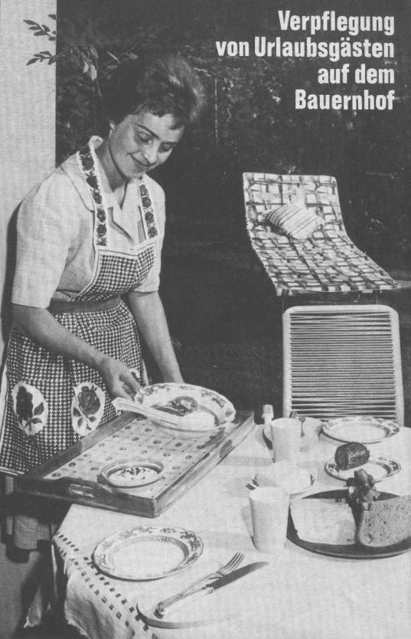
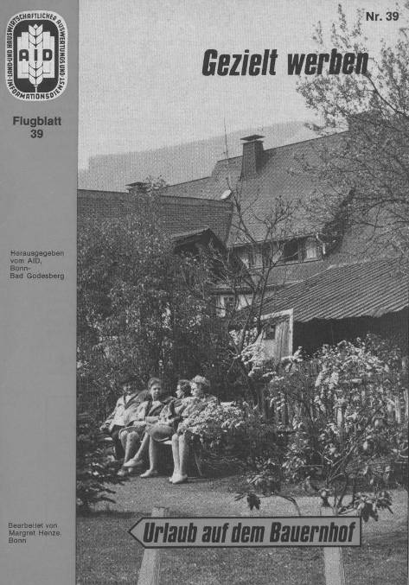
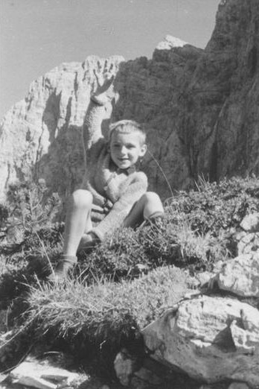
Rural Tourism 1970/80
Complement to agriculture
Low budget clientele
Basic level of equipments and services
“Outside” the professional tourism business
Marketing based on indivual effort
Almost no brands or labels
Strong support policies

Slide 7





















Rural Tourism 2010
90.000+ associated accommodation units in Europe 27
Level of association 20-25% → total offer between
360-450.000 units
20% “Agro”-tourism (working farms)
< 20% rooms “B&B style”, > 80% self-catering
15% of accommodation capacity in Europe
Diversification of target markets
Trend product based on rural assets

Slide 8
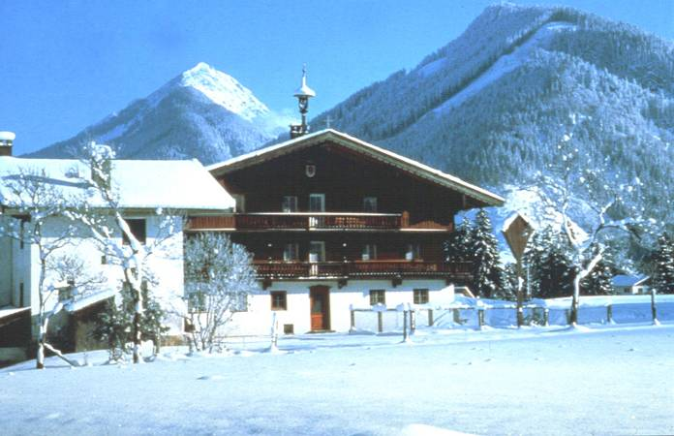

Slide 9
Market orientation
Expectation
+ Satisfaction
= Quality

Slide 10

Qualitool: virtual trust
International transparency
Self-evaluation
  → External audit through national organisations
Training
Continuous improvement

Slide 11
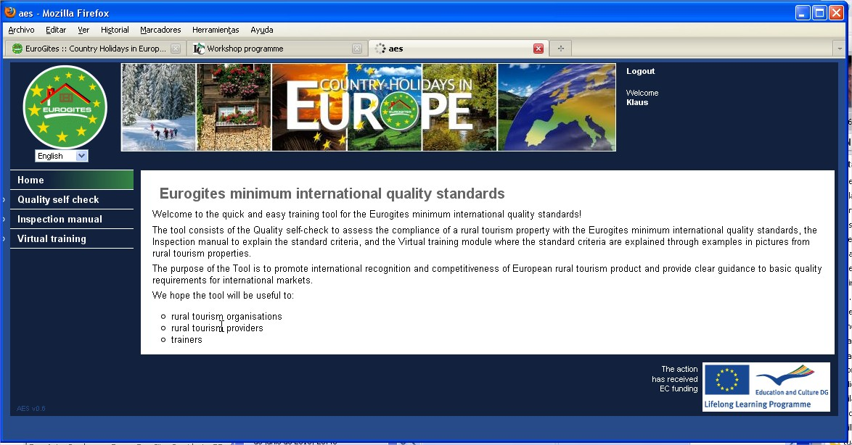

Slide 12
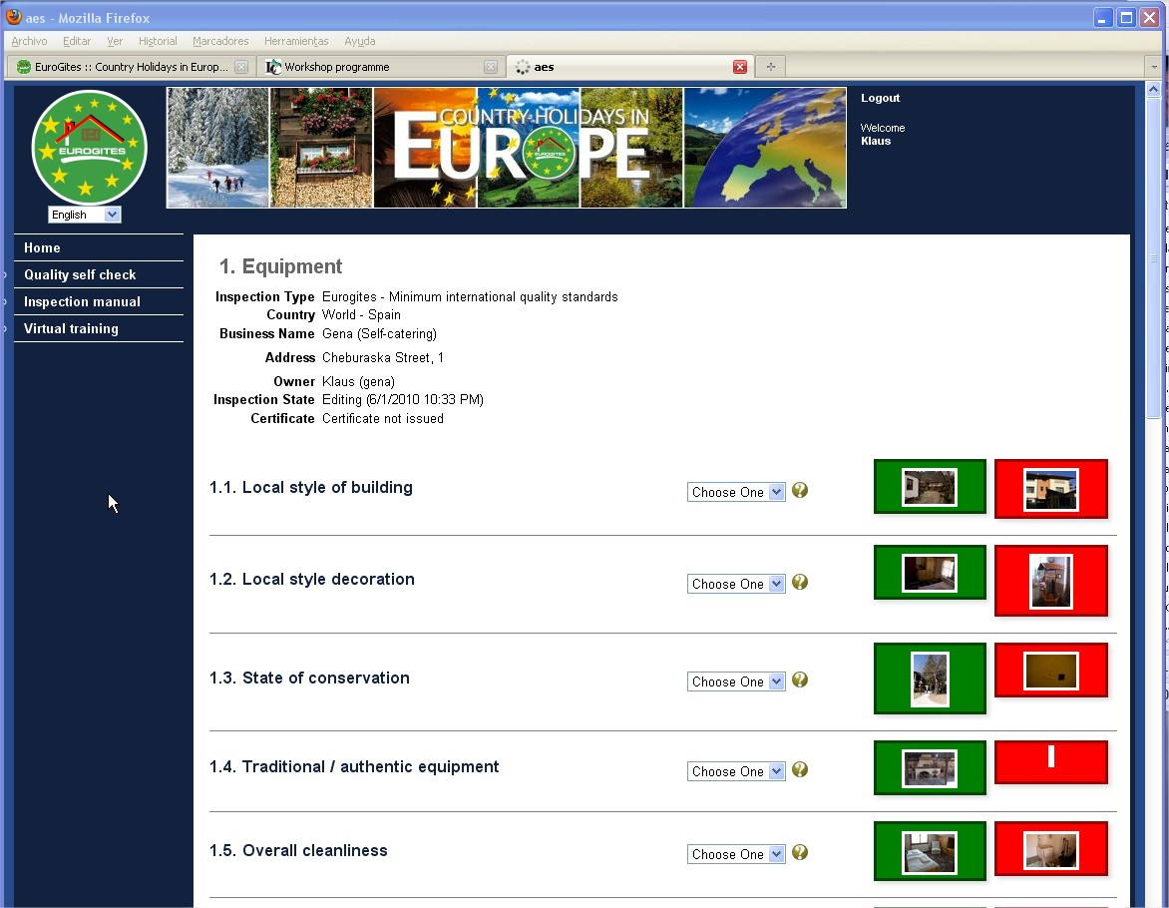

Slide 13
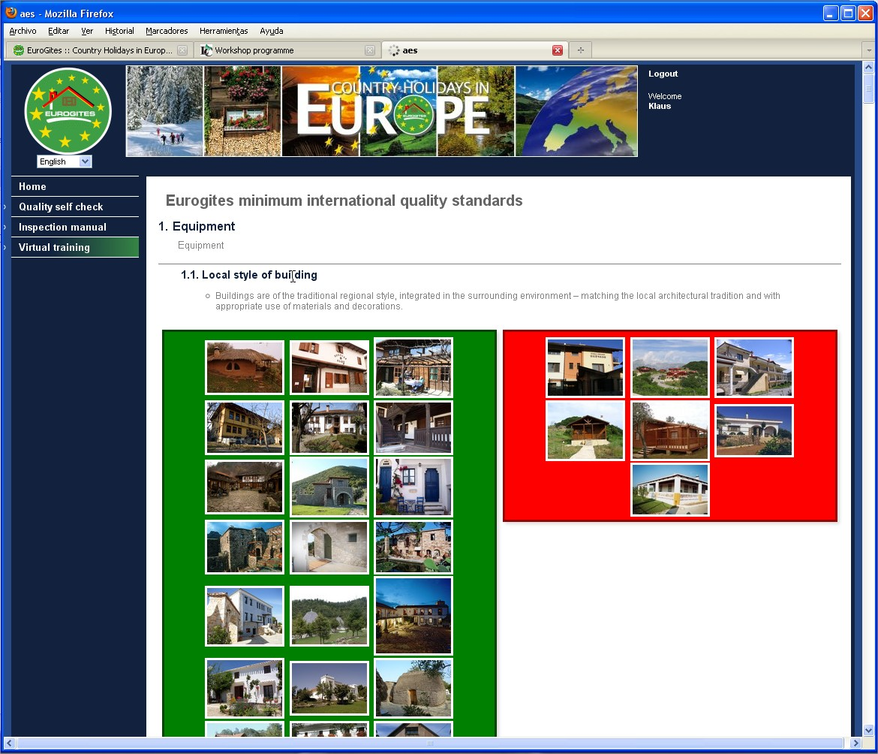

Slide 14
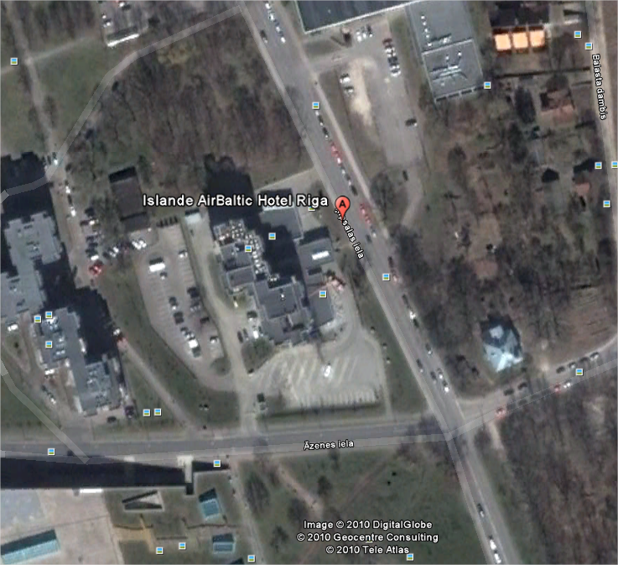






Trends 2020+
“LOHAS” customers: already more than 30%
Domestic market prevails (> 85-90%), but high growth potential for international demand
Changes of consumer behaviour: core services, price sensitive
Individual packaging with high quality guarantee versus “All-Inclusive”
Virtual Trust – Social Media substitute mouth-to-ear
Internet shifts the power from
travel trade to the client
Mobile Internet + GPS
Experience Economy: “tell a story”

Slide 15
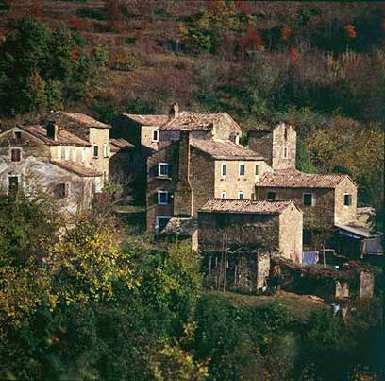
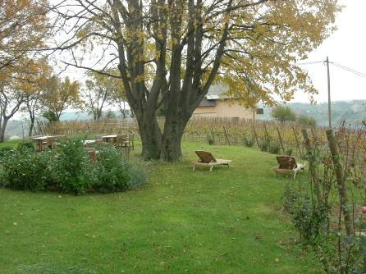
So what?

Slide 16


The “Heidi”-understanding
Human / personal contact
Local population as main actor
Integration of the visitor in local culture and life
Land romantics
Complementary activity
Standards and professionality are secondary

Slide 17
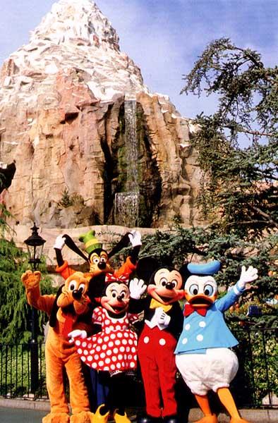
The Disneyland-understanding
Value is given to single assets available in rural areas
“Experience” as main driver
First “what”, then “where”
“No risk, no problem”
Competitive price
Professionality and high standards

Slide 18
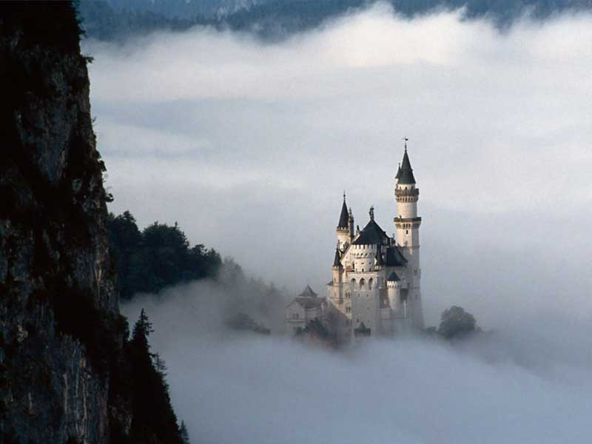
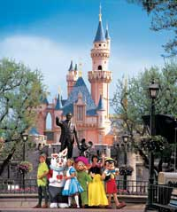
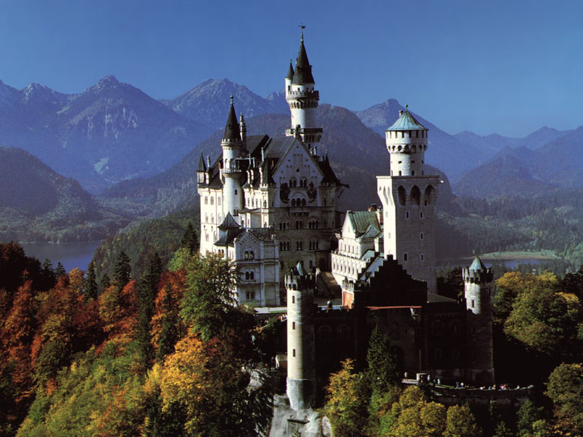
Two sides of the same coin

Slide 19
A vision for 2040 ?
Internationally competitive, transparent, and reliable
Leading in sustainability
Tailor-made holiday experiences
Valorization of any rural assets
Consumer-based quality and product development
E-community driven
Dynamic real-time packaging and booking through mobile devices

Slide 20
THANK YOU FOR YOUR ATTENTION!

